Slide 1
ITSM – Session 7
Phalachandra HL
Acknowledgements:
Significant portions of the information in the slide sets presented through the course in the class are extracted from IT Systems Management -Rich Schiesser and other books/Internet. Since these were intended for presentation in the class room for teaching, instructor resources has been requested from the publisher, but not received yet. I would like to sincerely thank, acknowledge and reiterate that the credit/rights remain with the original authors/publishers only

Slide 2
IT Infrastructure Management
Recap - 1
IT Infrastructure Systems Management, involves managing the IT Services running on the IT infrastructure environment components like the Servers, Disk Storage, DBs, Networks and Desktop environments for providing a stable and responsive IT environment
We discussed on the support needed from executives, organization structure and positioning of the groups which provide these management services, given that one of the KSF are people, we discussed on approaches for staffing and retaining people with required skills and skill levels, the personal and business ethics or lack of it and it’s impact in-terms of legislation and what that drives into organizations
We also looked at how to evolve the services to a customer centric approach and leveraging the best practices using frameworks like ITIL
Then as part of the 12 Key processes which would discuss as part of the course, we discussed on the processes for managing Availability, Performance –Tuning, Production Acceptance process, Change Management and Problem Management.

Slide 3
IT Infrastructure Management
Recap - 2
In the last session as part of discussing the Change Management, we looked at the change to be the modifications to and in the IT environment, which can impact the stability and responsiveness of the IT infrastructure environment. Change was to add value and discussed that if it is for adding value (most times when proactive) or it would be wasting (significant times when reactive since its for bringing in stability and responsiveness) value
We looked at few other definitions of Change Management, Production environment, Emergency change etc.
Change management had around 7 components which could be grouped as Change control (Request, Prioritize and Approve) and Change coordination (Collaboration, Schedule, Communicate and Implement). Components of Change Management
We also talked about the current drawbacks or challenges of the change management processes
We also discussed on the 13 steps for implementing the change management process from Identifying the sponsor, Assigning a process owner, selecting the cross-functional team, scheduling the meetings, making all the team members to be aware of the roles and responsibilities, come up with an articulation of the benefits so as to enable to be sold and embraced by the rest of the organization.
We discussed on the metrics, priorities, having a common definition, on the Emergency changes metrics and the ways of using the same to determine the maturity and state of the change management process.and then discussed on the design of the initial change management process, policy statements, CAB and refinement to the processes.

Slide 4
IT Infrastructure Management
Recap - 3
We also discussed Problem Management as a process used to identify, log, track, resolve, and analyze problems impacting the IT services. We looked at how a call initiated by a customer as an incident, gets analysed and logged as a problem or resolved as a Service request. We looked at a Service desk, as a function and the advantages and disadvantages of a segregated or an integrated Service desk.
We also looked at the steps involved in designing a problem management process right from choice of a sponsor, process owner, cross functional team, choice of problem tracking tool, requirement prioritization, logic for prioritization of problems, call handling process, metrics, Client issues with problem management,
We also looked at assessing of these Change and Problem management process and streamlining them.
We would be looking at the Storage Management and Network Management as part of the Session today.

Slide 5
Storage Management Process
BITS Pilani, Deemed to be University under Section 3 of UGC Act, 1956

Slide 6
ITSM : Storage Management
Introduction and Definition of Storage Management
Storage involves storing of information for safekeeping and retrieving it when required again. This will need to be achieved reliably, with integrity, within reasonable and acceptable response times. This could involve following some of the established standards as the SNIA SMI-S for management of attributes of hardware and management software or Cloud Data Management Interface (CDMI) which focusses on interoperability.
Definition of Storage Management : Storage management is a process used to optimize the use of storage devices, and to protect the integrity of data for any media on which it resides.
Optimizing the use of storage devices would be in terms of
Maximizing the amount of usable data written to and read from these Storage units at acceptable rate of response (Performance)
Making available adequate amount of space without over provisioning (Capacity)
Protecting the integrity of data i.e. data will always be accessible to authorized users in the same state where it was stored
Making the data to be Reliable and by being tolerant to failure and having an ability to Recover even in case of disastrous
Supporting Storage management actions like configuration discovery, provisioning and trending, security, compliance or cost management.
Storage Management would be around these 5 areas above

Slide 7
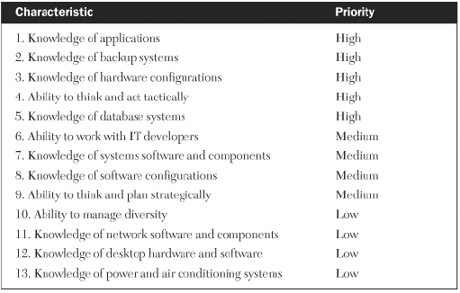
ITSM : Storage Management
Storage Management Process Owner
The individual who is assigned as the owner of the storage management process should have a broad basis of knowledge in several areas related to disk space resources. These areas include applications, backup systems, hardware configurations, and database systems.
Due to the dynamic nature of disk-space management, the process owner should also be able to think and act in a tactical manner.
Some of the other desirable characteristics to look for when selecting this individual.
The characteristics could be similar for other related processes like Capacity Planning, Performance and Tuning, Change Management, Disaster Recovery.

Slide 8
ITSM : Storage Management
Capacity Management - 1
Storage Capacity management consists of providing sufficient data storage to authorized users at a reasonable cost
Storage capacity includes
Large quantities of disk farms accessible to servers or mainframes.
Main memory and magnetic disk storage for all computes like mainframes, midrange computers, workstations, servers, and desktop computers.
Data storage capacity also includes alternative storage devices such as optical disks, magnetic drums, open reel magnetic tape, magnetic tape cartridges and cassettes, digital audio tape, and digital linear tape. (significant of these are obsolete or uncommon now)
Activities towards Maximizing the efficient use of data storage is cantered around large-capacity storage devices such as high volume disk arrays, as large capacities of these devices, when left unchecked, can result in poorly used or wasted space

Slide 9
ITSM : Storage Management
Capacity Management - 2
There are a number of methods to increase the utilization of the storage devices.
Instituting a robust capacity planning process across all of IT, which will identify requirements for disk space in advance enabling planners to propose and budget the most cost effective storage resources to meet forecast demand.
Monitor disk space usage to proactively spot unplanned data growth, data fragmentation, increased use of extents, and data that has not been accessed for long periods of time. A process which can use tools as necessary and heighten awareness about responsible disk space management.
IT Infrastructures prominently use magnetic storage disks, tapes and High Density tapes with capacity of 50GB and higher. While magnetic disks are the most common type of storage device within an infrastructure
Usage of Solid state devices which are persistent, have smaller form factor, lower power consumption with reasonably high capacity are getting to be popular.
Notes:
An extent is a contiguous area of storage reserved for a file in a file system, represented as a range of block numbers. A file can consist of zero or more extents; one file fragment requires one extent.
Architecture
Virtual Volumes (Physical Logical)

Slide 10
ITSM : Storage Management
Performance Management - 1
There are a number of considerations when configuring infrastructure storage for optimal performance. These could be
Size and type of processor main memory on the server
Size and type of main memory varies from few GBs to 10s of GBs limited by the physical memory slots
Number and size of buffers on the server
The number and size of buffers are calculated to maximize data-transfer rates between host processors and external disk units, without wasting valuable storage and cycles within the processor.
Size of swap space on the Server
Swap space is sized to minimize processing time by providing the proper ratio of real memory space to disk space. A good rule of thumb for this ratio used to be to size the swap space to be equal to that of main memory

Slide 11
ITSM : Storage Management
Performance Management - 2
Considerations when configuring storage infrastructure for optimal performance (Cont.)
Number and type of channels
Channels connecting host processors to disk and tape storage devices vary as to their transfer speed, their technology, and the maximum number able to be attached to different platforms. The number and speed of the channels influence performance, response, throughput, and costs.
Device controller configuration
Tape and disk controllers have variable numbers of input channels attaching them to their host processors, as well as variable numbers of devices attaching to their output ports
Performance can be maximized at reasonable costs by analysis and determining the correct number of input channels and output devices per controller
Logical volume groups
Logical volume group assembles together two or more physical disk volumes into one logical grouping for performance reasons

Slide 12
ITSM : Storage Management
Performance Management - 3
Considerations when configuring storage infrastructure for optimal performance (Cont.)
Amount of disk array cache memory
Disk arrays have varying sizes of cache memory which supports performance. The size, the cache hit and miss numbers, the algorithms used for prefetching and clearing based on data locality and usage etc. can be used for increasing performances
Storage area networks (SANs)
Typically has an additional link for exchange of data and provides full pipe bandwidth by using a switch between servers and switches.
Network‐attached storage (NAS)
Typically NAS is a dedicated fileserver with the LAN network replacing the SAN.

Slide 13
ITSM : Storage Management
Reliability Management - 1
Robust storage management implies that adequate amounts of disk storage are reliably available to users whenever they need it and wherever they are.
Manufacturers began designing into their disk storage systems redundant components such as backup power systems, dual channel ports to disk controllers, and dual pathing between drives and controllers.
Fault-tolerant systems began in which entire processing environments were duplicated in a hot standby mode. These systems essentially never went down, making their high cost justifiable, but for environments with huge disk farms this option was very expensive

Slide 14
ITSM : Storage Management
Reliability Management - 2
RAID devices having techniques like
RAID 0 – Stripe (Performance)
RAID 1 – Mirror (Availability)
RAID 10 or 01 –Striped Mirror or Mirrored Stripe (Performance and Availability)
RAID 2-3-4 Bit Parity, Byte Parity, Block Parity (Dedicated) (not very prevalent)
RAID 5 – Distributed Parity (Availability with single disk failure)
RAID 6 – Dual Parity (Availability with Dual disk failures)
By understanding the different RAID levels, storage management process owners can better evaluate which scheme is best suited for their business goals, their budgetary targets, their expected service levels, and their technical requirements

Slide 15
ITSM : Storage Management
Recoverability Management - 1
There are several methods available for recovering data that has been altered, deleted, damaged, or otherwise made inaccessible
In environments architected with an offsite replicated data recovery site which are updated synchronously or asynchronously, recovery happens immediately with the data being available from the replicated site.
Data could be backed up for supporting recovery and the recovery technique would depend on how data was backed up
Some of the commonly used backup techniques are
Full backup (Cold backup, Full Volume Backup, Full offline backup)
Backup of the complete data at a certain point in time
Incremental backup (Incremental offline backup)
Copies data that has changed since the last full or incremental backup
Much faster, but takes longer to restore
Cumulative (differential) backup
Copies data that has changed since the last full backup
Slower than incremental backup, but faster to restore
Synthetic (constructed) full backup
A full backup generated from the latest full backup and all the incremental backups performed after that full backup
Enables full backup copy to be done offline

Slide 16
ITSM : Storage Management
Recoverability Management - 2
Some of the commonly used backup techniques (Cont.)
Physical Online backup (Online backup or Hot backup)
It is a powerful backup technique that offers two very valuable and distinct benefits:
Databases can remain open to users during the backup process.
Recovery can be accomplished back to the last transaction processed.
Logical Backup (exporting files, exporting to binary files)
Logical backups are less complicated and more time consuming to perform.
This has advantages of
Export can be made online, enabling 24/7 applications and databases to remain operational during the copying process.
Small portions of a database can be exported and imported, efficiently enabling maintenance to be performed on only the data required.
Exported data can be imported into databases or schemas at a higher version level than the original database, allowing for testing at new software levels.
Disk to Disk backup
Supports smaller backup window and RTO.
Copy can be used for other activities as well as staging area for tape backups

Slide 17
ITSM : Storage Management
Recoverability Management - 3
Some of the commonly used terminologies which are relevant for data backup and recovery are
Backup Window, RTO and RPO
Expiration dates, Retention periods, Recycle periods
Generation data groups is a mainframe mechanism of creating version of a data file like backup
Offsite retrieval times is max time allowed before the data stored on tape offsite needs to be brought back to the datacenter to allow retrieval of data.
Tape density, Tape format, Tape packaging, Tape Shelf life
Mechanical tape loaders, automated tape library systems, and movable tape rack systems can all add a degree of labor-saving automation to the storage management process. As with any process automation, thorough planning and process streamlining must precede the implementation of the automation.
Notes:
Backup Window
The backup window is the amount of time available for performing the backup operation that do not interfere with production data processing on any given data. Typically used with cold backup and can have a daily/weekly or monthly windows
RPO : Recovery Point objective
RPO, or Recovery Point Objective, is focused on data and business loss tolerance in relation to the data. RPO is determined by looking at the time between data backups and the amount of data that could be lost in between backups
E.g. The last available good copy of data upon an outage is from 18 hours ago, and the RPO for this business is 20 hours then we are still within the parameters of the Business Continuity Plan’s RPO
So if the RPO is 12 hours then the backup needs to happen periodically before every 12 hours
RTO : Recovery Time objective
The Recovery Time Objective (RTO) is the duration of time within which a business process must be restored to a service level after a disaster, in order to avoid unacceptable consequences associated with a break in continuity
The amount of time that can pass before the disruption begins to seriously and unacceptably impede the flow of normal business operations.
Backup & recovery mechanisms have to be chosen so that the RTO is always < than specified

Slide 18
ITSM : Storage Management
Integrity Management
Storage Integrity has two parts
Data integrity which is the overall completeness, accuracy and consistency of data. This can be indicated by the absence of alteration between two instances or between two updates of a data record, meaning data is intact and unchanged (predominantly unintentional change)
Data Security would look to protect data, from destructive forces and from the unwanted actions of unauthorized users.
Data integrity in a storage device needs to be looked at from two perspectives
Data integrity of the data stored in the storage device (at rest)
This includes encryption of data
Access control to the devices
Ensuring of the techniques which would support mutual exclusion etc
Data integrity of the data on the wire
This would include the protocol security
Encryption of data on the wire

Slide 19
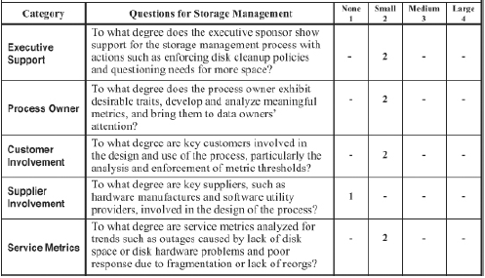
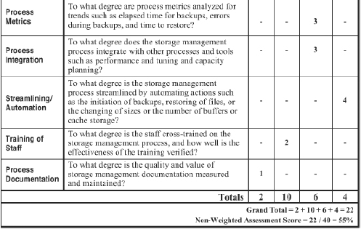
ITSM : Storage Management
Assessing an Infrastructure’s Storage Management Process
Like with the other processes, the following worksheet method for assessing the overall quality, efficiency, and effectiveness of a storage management process
Quality
Executive support
Process owner
Process documentation
Efficiency
Supplier involvement
Process metrics
Process integration
Streamlining/automation
Effectiveness
Customer involvement
Service metrics
The training of staff
Characteristics within each category is rated on a scale of 1 to 4 . 1 - 4 indicating no presence to a large presence of the characteristic.

Slide 20
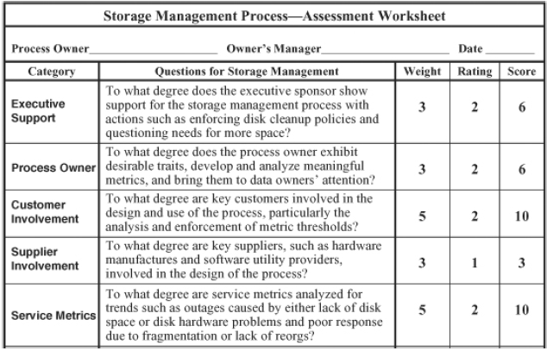
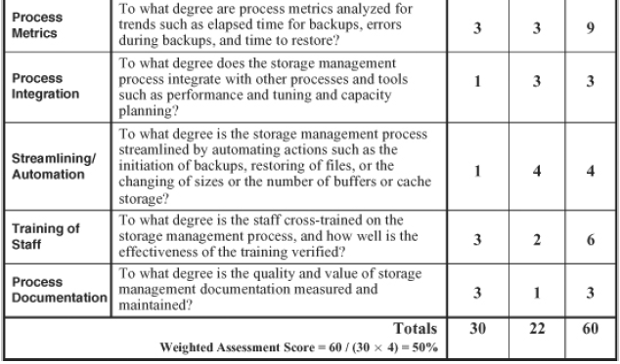
ITSM : Storage Management
Assessing an Infrastructure’s Storage Management Process
Worksheet with a weighing factor to assign relative importance provided for a particular category and the worksheet is enclosed.
Maximum Weight – 30
Maximum Rating Value - 4
Maximum Weighted Score
= Max Weight * Max Rating Value Max Weighted Score = 30 * 4
= 120
Weighted Assessment Score
= Total Score/Max Weighted Score
= 60/120 = ~0.50
= 50%

Slide 21
ITSM : Storage Management
Measuring and Streamlining the Storage Management Process
We can measure and streamline the storage management process with the help of the assessment worksheet
We can also measure the effectiveness of a storage management process with service metrics such as outages caused by either lack of disk space or disk hardware problems, and poor response due to fragmentation or lack of reorganizations.
Process metrics, such as elapsed time for backups, errors during backups, and time to restore help us gauge the efficiency of this process.
We can streamline the storage management process by automating actions such as the initiation of backups, restoring of files, or the changing of sizes or the number of buffers or cache storage

Slide 22
Network Management Process
BITS Pilani, Deemed to be University under Section 3 of UGC Act, 1956

Slide 23
ITSM : Network Management
Introduction
Definition of Network Management : Network management is a process to maximize the reliability and utilization of network components in order to optimize network availability and responsiveness
Maximizing reliability is a way of emphasizing high availability by ensuring network lines and the various components such as routers, switches, and hubs maintain high levels of uptime.
Maximizing utilization implies that performance and tuning activities involving these components for optimizing network responses.
Current networks come in a variety of sizes, scopes, and architectures, from a simple dual-node local network in your house to a sophisticated, encrypted network connecting tens of thousands of nodes worldwide.
Given this diverse variety and scale of the networks, (although there are common elements of the process) there is no single detailed network management process that will apply to all of the various network environments.
Notes:
CMIP/CMIS based OSI model
SNMP which is OSI based

Slide 24
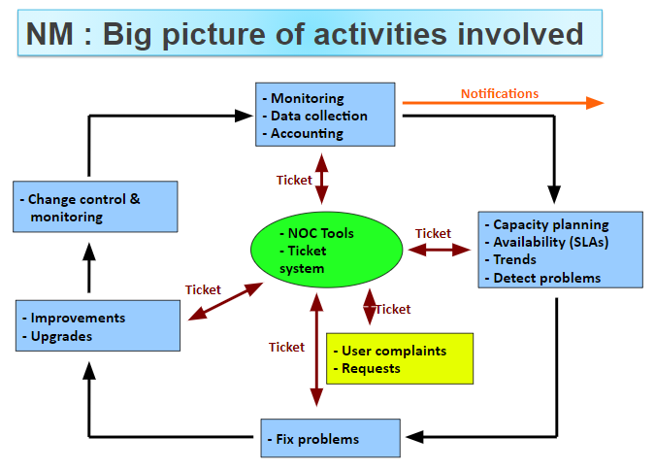
ITSM : Network Management
Introduction (Contd.)
Notes:
CMIP/CMIS based OSI model
SNMP which is OSI based

Slide 25
ITSM : Network Management
Introduction (Contd.)
Traditionally Network Management as seen from an IETF Internet model would involve managing either the network elements or services using SNMP versions. This as an approach supports, monitoring, security etc.
SNMP architecture involves a Manager, Agent and a MIB.
SNMP Protocol over UDP
Get, Get Next, Set, Trap etc.
an OSI model perspective can be looked at as managing FCAPS++ using Organizational, Information, Communication and functional models.
F -> Fault Management
C -> Configuration Management
A - > Accounting Management
P -> Performance Management
S -> Security Management
As can be seen, most of these Network Management related functionalities are addressed in some of ITSM processes or functions
Problem Management
Change, Tuning & Configuration
Partly with monitoring
Performance Mgmt, Availability Capacity
Security Management
Notes:
CMIP/CMIS based OSI model
SNMP which is OSI based

Slide 26
ITSM : Network Management
Introduction (Contd.)
There is also the CIM/WEBEM based Network Management which facilitates a Web Based Enterprise Management.
CIM Client, CIM Object Manager, CIM repository, CIM provider and Managed object.
Notes:
CMIP/CMIS based OSI model
SNMP which is OSI based

Slide 27
ITSM : Network Management
Key Decisions about Network Management
Infrastructure organizations will need to make decisions on what, who, and how will the network be managed, using what will it be managed, Service and Quality levels to be expected. This will influence the strategy, direction and cost of the IT network management.
Summarily Network Management process are influenced by the following key 6 decisions, which define the scope of responsibilities and the functional areas that are required to employ the process on a daily basis.
What will be managed by this process?
Who will manage it?
How much authority will this person be given?
What types of tools and support will be provided?
To what extent will other processes be integrated with this process?
What levels of service and quality will be expected?

Slide 28
ITSM : Network Management
Key Decisions about Network Management - 1
What will be managed by this process?
A network has different topologies, platforms, protocols, security and suppliers.
Different groups may be responsible for different aspects of the network E.g.
Encryption of data by one group
Network Security by another group
Network passwords by computer operations with helpdesk
The above decision will lead to what will be managed by the process being designed
These responsibilities could change over time and context, but the goal is to reach an early consensus and communicate with all appropriate parties
Since technologies evolve, the decision where they will need to reside will also need to evolve
Notes:
Instead of having a separate telecom department manage the PBX desk telephone, voice- and videoconferencing, mobile voice communications, and voice messaging, create a team that looks at all communications through the lens of usage profiles. That team should define and support the communications modes (voice, video, text, email) and devices (desk phones, smartphones, laptops, tablets) according to the workflow requirements of each usage profile.
Merge communication help desk personnel and technicians with PC/Mac/tablet/user software help desk teams.

Slide 29
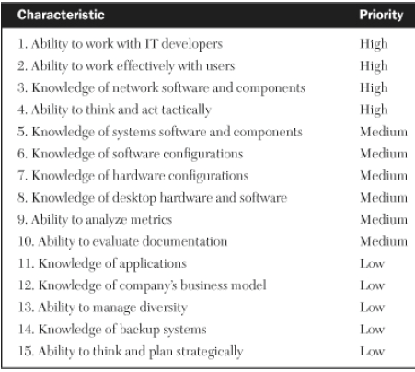
ITSM : Network Management
Key Decisions about Network Management - 2
Who will manage it?
Once its determined on what is going to be managed by which group, that naturally determines which department within the infrastructure will be assigned the responsibility for heading up the design, implementation, and ongoing management of this process. Then a process owner will be identified within the department for the network management process.
The characteristics expected for the Network Management process owner would be
Notes:
A network-management process owner should be knowledgeable about network operating
systems, utility programs, support software, and key hardware components such as routers,
switchers, hubs, and repeaters.

Slide 30
ITSM : Network Management
Key Decisions about Network Management - 3
How Much Authority Will This Person Be Given?
Adequate authority and support is necessary to be provided for enforcement for ensuring the effectiveness of the process.
This could necessitate
Managers to surrender some of their authority over the network to the Network management process owner.
Managers to support their process owner in situations of conflict
Conflicts arise for scenarios as below
Enforcement of network security policies such as “if, when, and how” data over the network will be encrypted
User expectations about the infrastructure backing up desktop data instead of the more practical method of saving it to the server
Degree of authority a network management process owner has over the network suppliers can instigate conflict when not communicated to suppliers
Notes:
A network-management process owner should be knowledgeable about network operating
systems, utility programs, support software, and key hardware components such as routers,
switchers, hubs, and repeaters.

Slide 31
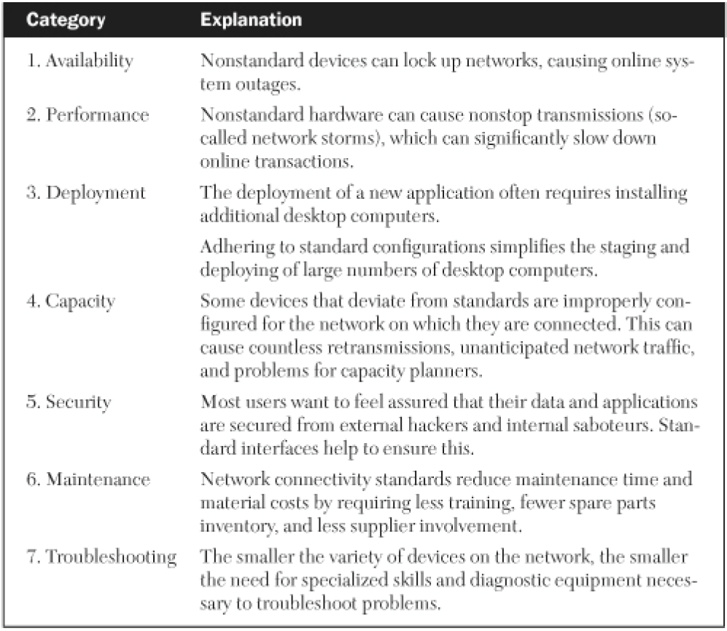
ITSM : Network Management
Key Decisions about Network Management - 3
How Much Authority Will This Person be Given (Contd.)
Enforcement of network connectivity standards as a lot of Customers feel they warrant an exception like a non standard interface device
Reasons for Network Connectivity Standards
Executive’s reaction to mistakes the process owner may make due to factors such as experience, training, fatigue, judgment, negligence, oversight, attitude, abuse should all be considered in determining the response for use/misuse of Authority, in case the security enforcement authority is delegated
Notes:
A network-management process owner should be knowledgeable about network operating
systems, utility programs, support software, and key hardware components such as routers,
switchers, hubs, and repeaters.

Slide 32
ITSM : Network Management
Key Decisions about Network Management - 4
What Types of Tools and Support Will Be Provided
Decisions on the type of tools and the amount of vendor support that will be provided will influence the costs of managing the network.
More Advanced/Sophisticated the tool, more expensive it will be, but the cost of support could reduce. The other way round, there may be a more expensive support needed to support the managing of the network.
Network Management Tools: A variety of network tools are available to monitor and manage a network. Some are incorporated in hardware components, but most are software-based. Costs can range from just a few thousand dollars to literally millions of dollars for multi-year contracts with full onsite maintenance.
Network Documentation Tools: Since effective network management needs clear, concise, and accurate documentation to support, repair, and maintain the complex networks. Typically this would lack emphasis and there is reluctance to build the same.
Having the Network Management process owner to be accountable for the documentation and supporting the role with a skilled resource and a good tool to document can be a good approach to address this.
Notes:
A network-management process owner should be knowledgeable about network operating
systems, utility programs, support software, and key hardware components such as routers,
switchers, hubs, and repeaters.

Slide 33
ITSM : Network Management
Key Decisions about Network Management - 5
To What Extent Will Other Processes Be Integrated With This Process
A well-designed network management process will have strong relationships to other systems management processes like the availability, performance and tuning, change management, problem management, capacity planning, and security.
The extent to which network management are integrated with these other processes by sharing tools, databases, procedures, or cross-trained personnel will influence the effectiveness of the process. E.g.
Capacity planning and network management could both share a tool that simulates network workloads to make resource forecasts more accurate
A tool that controls network access may have database access controls that the security process could use
Notes:
A network-management process owner should be knowledgeable about network operating
systems, utility programs, support software, and key hardware components such as routers,
switchers, hubs, and repeaters.

Slide 34
ITSM : Network Management
Key Decisions about Network Management - 6
What Levels of Service and Quality Will Be Expected
The expectations of the levels of Service and Quality is based on the negotiated agreement. These levels of service and quality, impact the cost of hardware, software, training, and support
This needs to be well understood by the groups responsible for agreement on the levels of service, their estimate of the budget needed, and the team which is executing on the agreement
Suppliers of the network components (such as routers, switches, hubs, and repeaters) should also be part of these negotiations since their equipment has a direct impact on availability and performance. Long-distance carriers are another group to include in the development of SLAs. Since the situations could be out of their control, they specify certain conditions under which they guarantee the levels of service.
Notes:
A network-management process owner should be knowledgeable about network operating
systems, utility programs, support software, and key hardware components such as routers,
switchers, hubs, and repeaters.

Slide 35
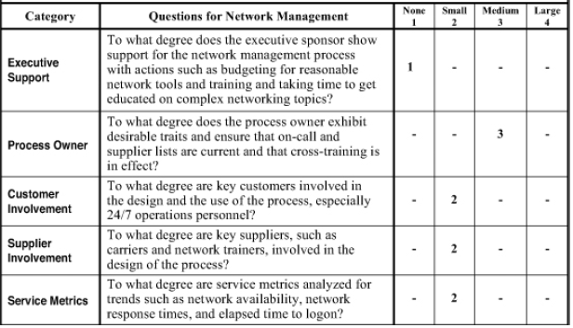
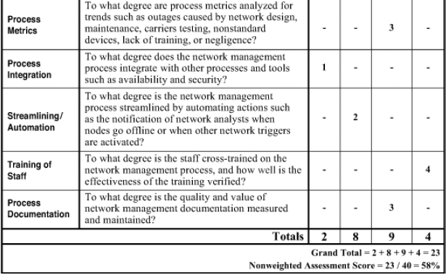
ITSM : Network Management
Assessing an Infrastructure’s Network Management Process
Continuing with the Worksheet for assessing the overall quality, efficiency, and effectiveness of the performance & tuning process. (without weighing factor)
Quality
Executive support
Process owner
Process documentation
Efficiency
Supplier involvement
Process metrics
Process integration
Streamlining/automation
Effectiveness
Customer involvement
Service metrics
The training of staff
Characteristics within each category is rated on a scale of 1 to 4 . 1 - 4 indicating no presence to a large presence of the characteristic.

Slide 36
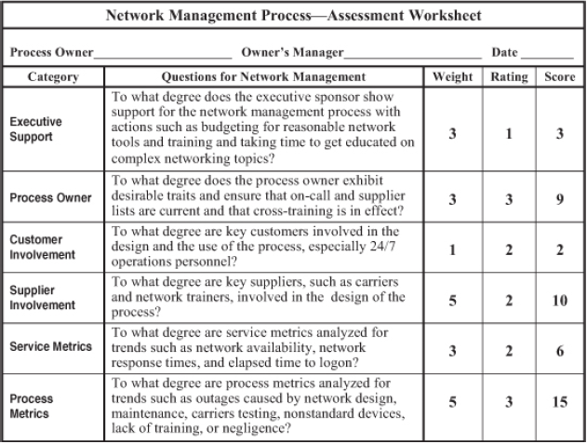
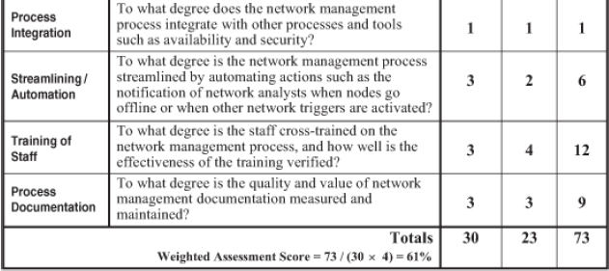
ITSM : Network Management
Assessing an Infrastructure’s Network Management Process
Worksheet with a weighing factor to assign relative importance provided for a particular category and the worksheet is enclosed.
Maximum Weight – 30
Maximum Rating Value - 4
Maximum Weighted Score
= Max Weight * Max Rating Value Max Weighted Score = 30 * 4
= 120
Weighted Assessment Score
= Total Score/Max Weighted Score
= 73/120 = ~0.61
= 61%

Slide 37
ITSM : Network Management
Measuring and Streamlining the Network Management Process
We can measure and streamline the network management process with the help of the assessment worksheet
We can measure the effectiveness of a network management process with service metrics such as network availability, network response times, and elapsed time to logon..
Process metrics, such as outages caused by network design, maintenance, carriers testing, nonstandard devices, lack of training, or negligence, help us gauge the efficiency of this process.
We can streamline the network management process by automating actions such as the notification of network analysts when nodes go offline or when other network triggers are activated

